Slide 1
Assignment on Story creation IN TABLEAU
Submitted By: Pooran Pragnya
November Batch (BDS)

Slide 2
Story Creation in Tableau
A story is a collection of sheets arranged in sequence. Each individual worksheet /dashboard in a story is called as a story point.
A story is sequence of visualization that work together to coney information.
Stories make case more compelling by showing how facts are connected and how decisions related to outcomes are made.
Dashboard looks awful if we use more than 3 or 4 worksheets so story comes into hand where we can use more number of worksheets than dashboard.

Slide 3
scenarios
Create a story to present all your insights to your team.
Show the sales in the south worksheets in your story.
Add a caption ‘sales and profit by year’ to the above story.
Duplicate the first caption and show the visual for machine type subcategory.
Add a caption “Machine sales and profit by year” for machine type subcategory.
check your story mini toolbar around the story point caption.
Select Blank in the story pane then drag your dashboard Regional Sales and profit onto the canvas and find some meaningful insights.
Add a caption “Underperforming items in the south” in the above story point.

Slide 4
9. Duplicate the above story point and show your result only for North Carolina and all the year.
10. Add a caption ‘Profit in North Carolina 2018-2021’ in the above story point.
11. Duplicate the above story point and show the profit in the North Carolina for 2018 and add a caption ‘Profit in North Carolina in 2018’.
12. Similarly show the profit for North Carolina for every year and add the caption.
13. Select drag to add text, drag it onto your view and enter the description for your dashboard ‘Introducing machines to the North Carolina market in 2021 resulted in loosing a significant amount of money’.

Slide 5
14. From the story pane, click blank and drag negative profit bar chart to the view.
15. Right click on Burlington mark (the bar) and select Annotate > Mark. In the edit Annotation dialog box that appears, delete the filter test and type “Machines in Burlington lost nearly $4000”.
16. Add a caption “where we are loosing machine profits in North Carolina?” to above story point.
17. Rename your story as “Improve Profits in the South” and check in the presentation mode.
18. Publish your story in Tableau Public.

Slide 6
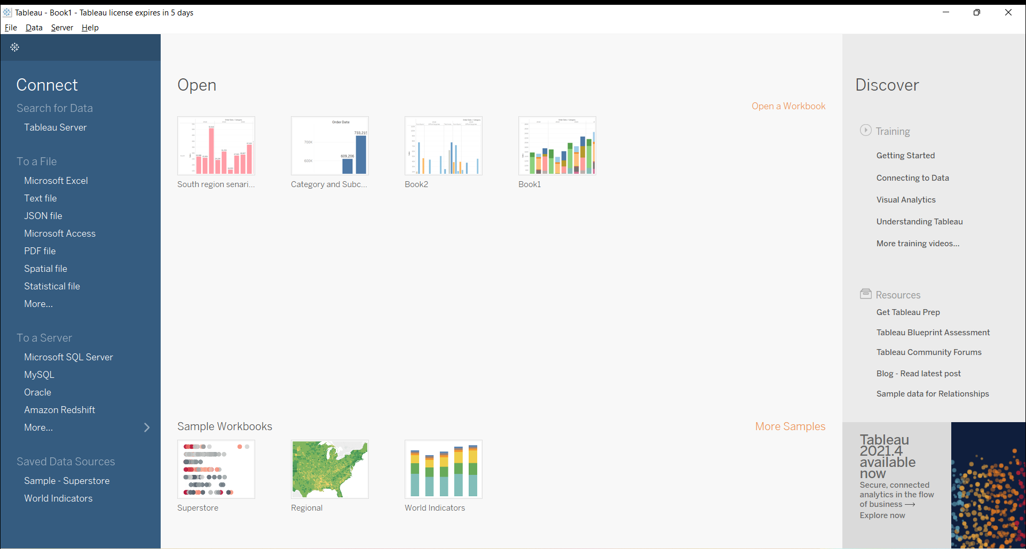
1. Create a story to present all your insights to your team

Slide 7
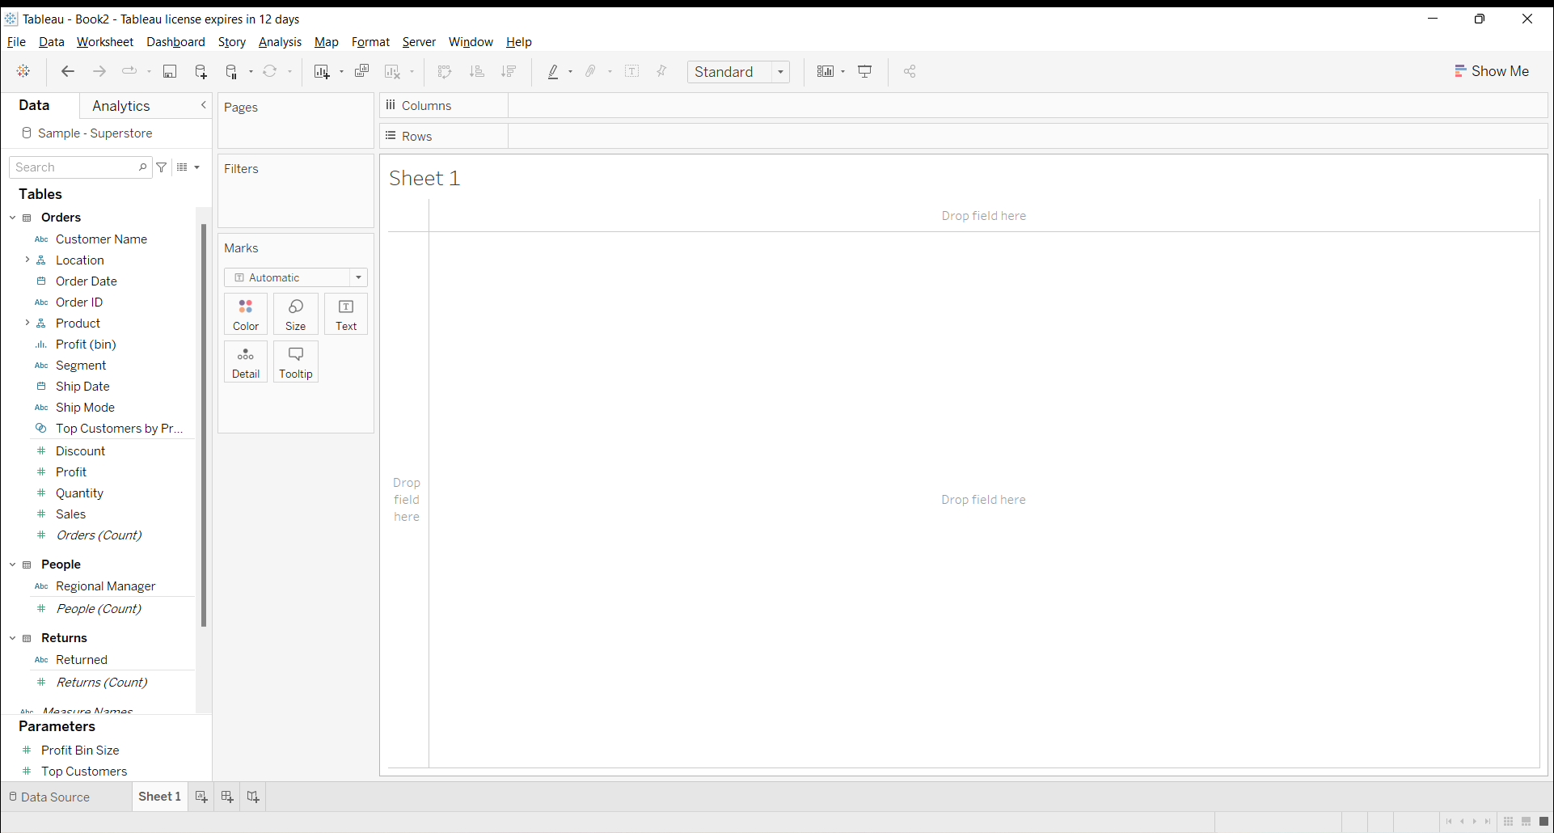

Slide 8
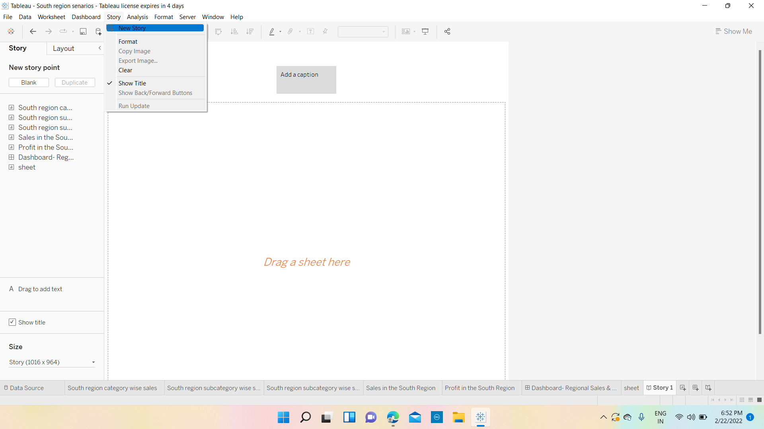

Slide 9
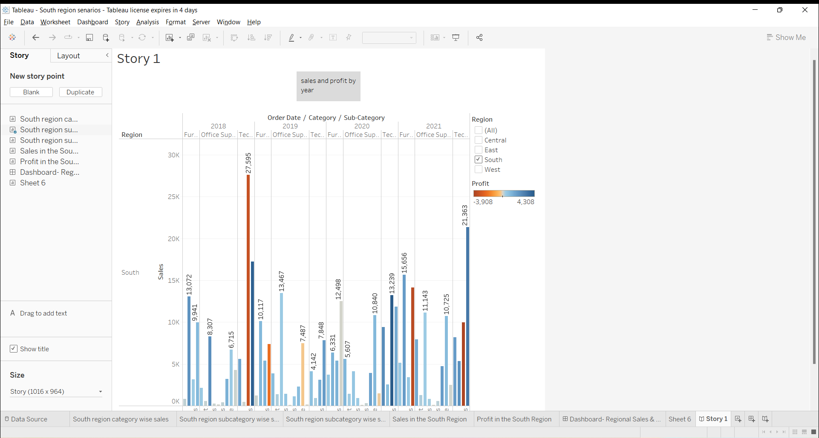
2. Show the Sales in the south worksheets in your story 3. Add a Caption ‘Sales and profit by year’ to the above story

Slide 10
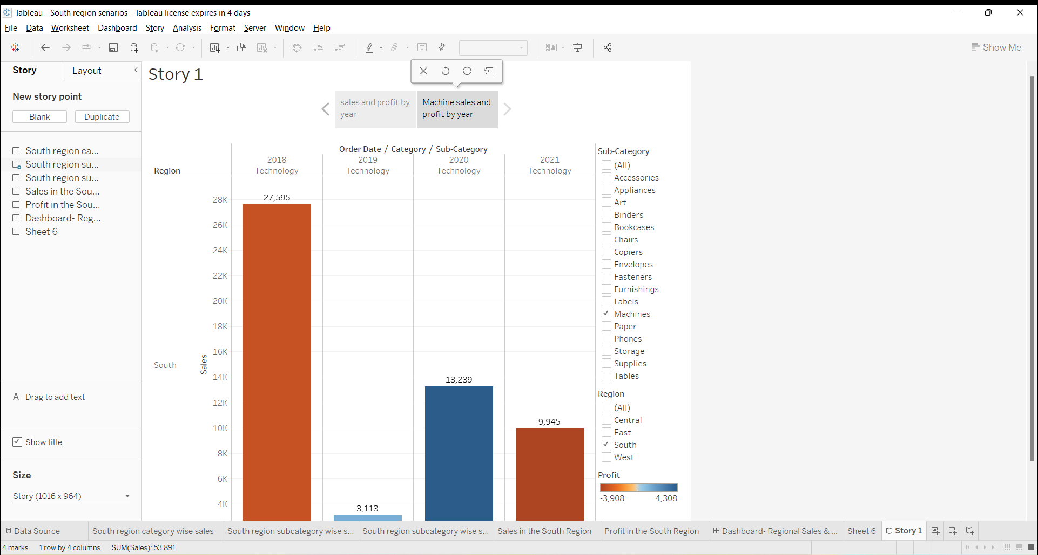
4. Duplicate the first caption and show the visual for machine type subcategory 5. Add a caption “Machine sales and Profit by Year for the story point

Slide 11

6.Check your story mini toolbar around the story point caption

Slide 12
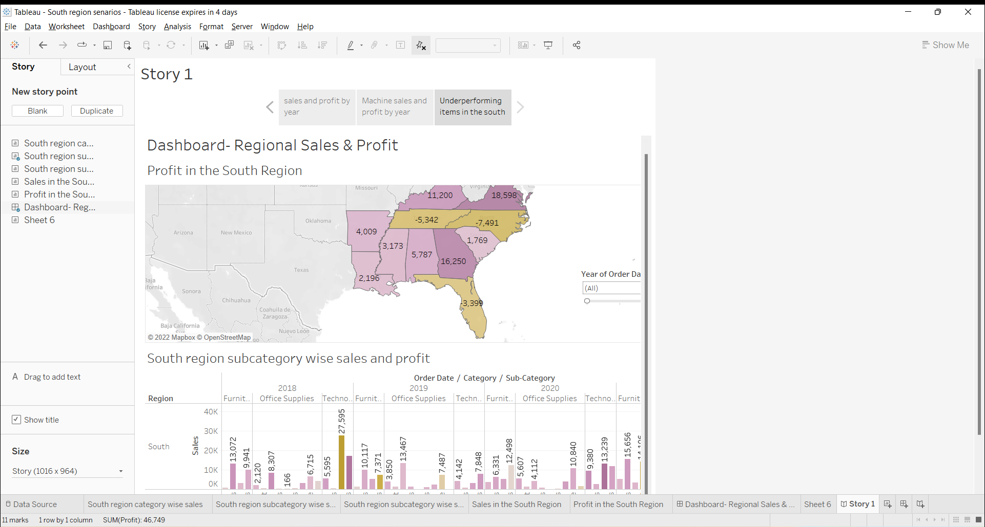
7. Select blank in the story pane then drag your dashboard ‘regional sales and profit onto the canvas and find some meaningful insights

Slide 13
Inferences From the above Dashboard are:
North Carolina, Tennessee and Florida have overall negative profit then other states in the south.
In North Carolina, Machine type subcategory has performed very poor compared to other subcategories in 2021.
In Tennessee, Binders subcategory has performed poor in 2021 compared to other subcategory.
In Florida, there was improvement in all subcategories in 2021 when compared with the remaining years.

Slide 14
8. Add a caption “underperforming items in the south” in the above story point

Slide 15
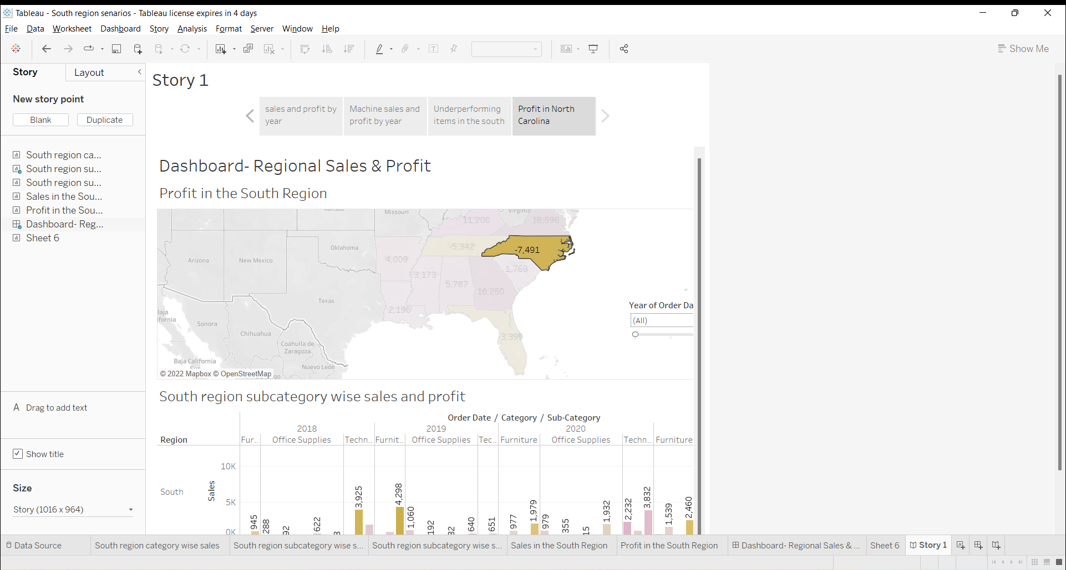
9. Duplicate the above story point and show your result only for North Carolina for all the years. 10. Add a caption “profit in North Carolina 2018-2021 to the above story point

Slide 16
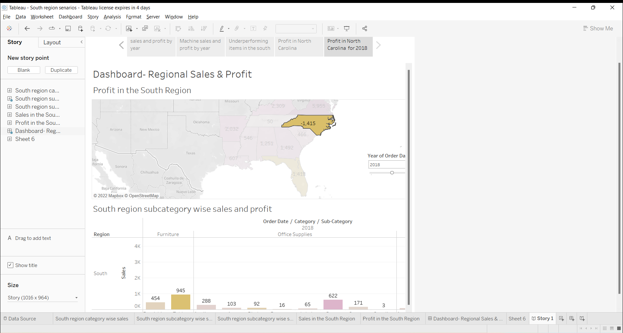
11. Duplicate the above story point and show the profit in the North Carolina for 2018 and add a caption “profit in North Carolina- 2018”

Slide 17
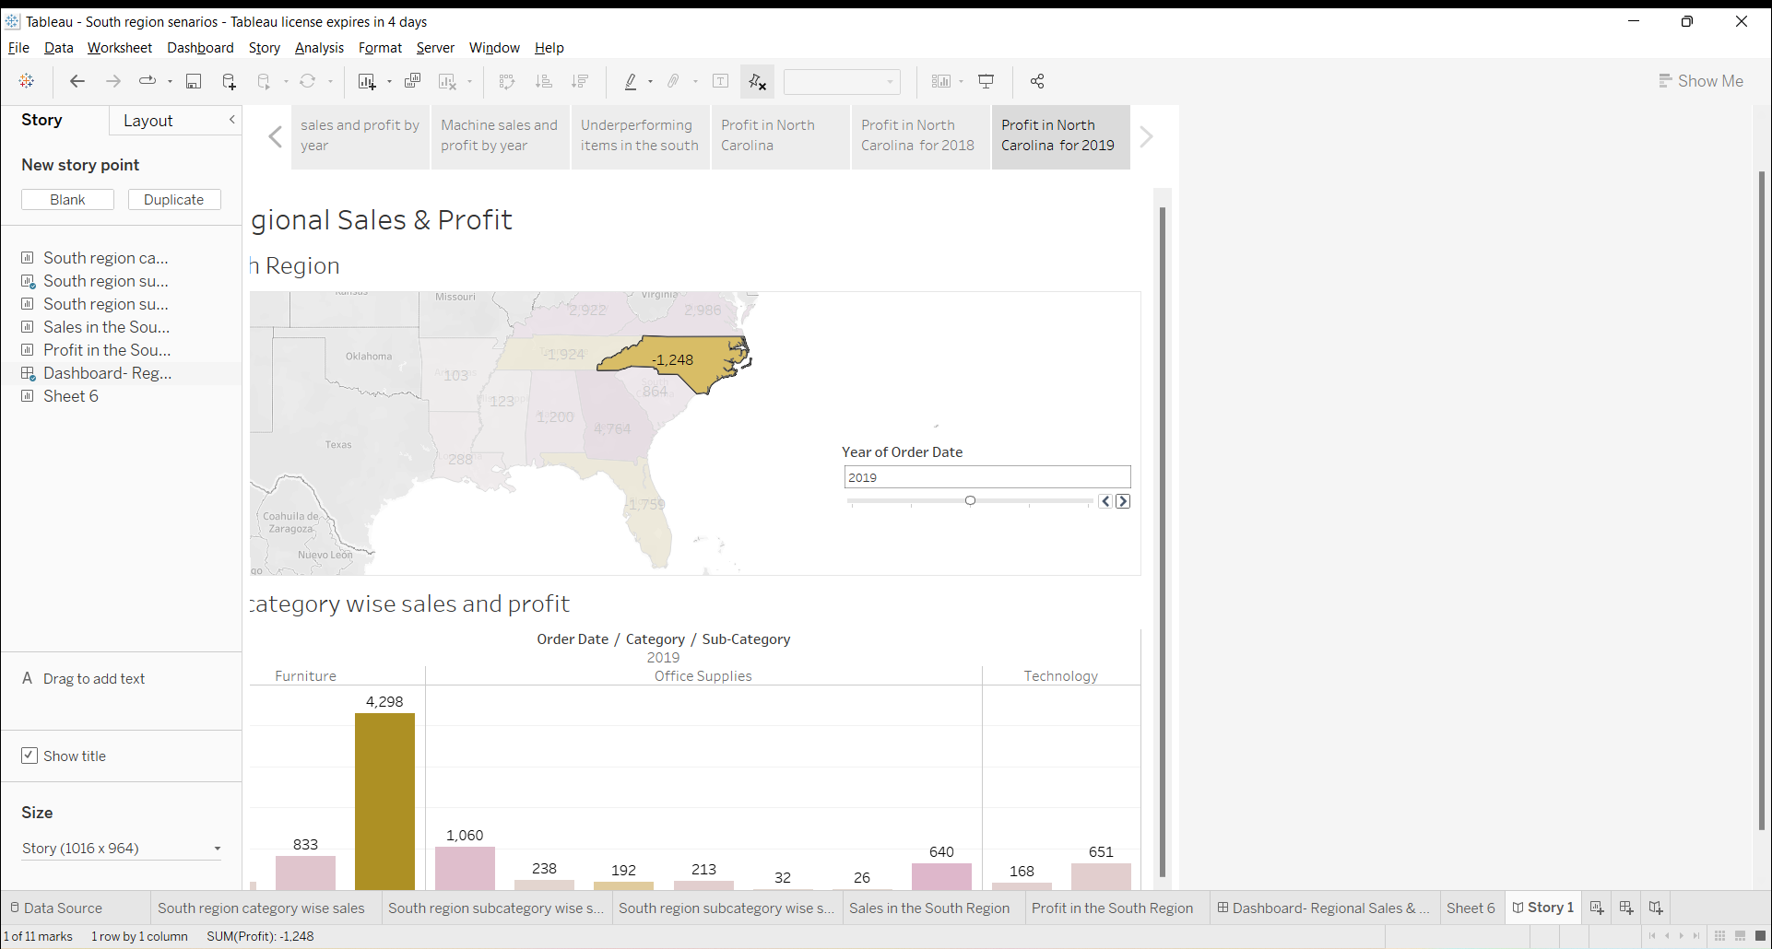
12. Similarly show the profit for North Carolina for every year and add the caption

Slide 18
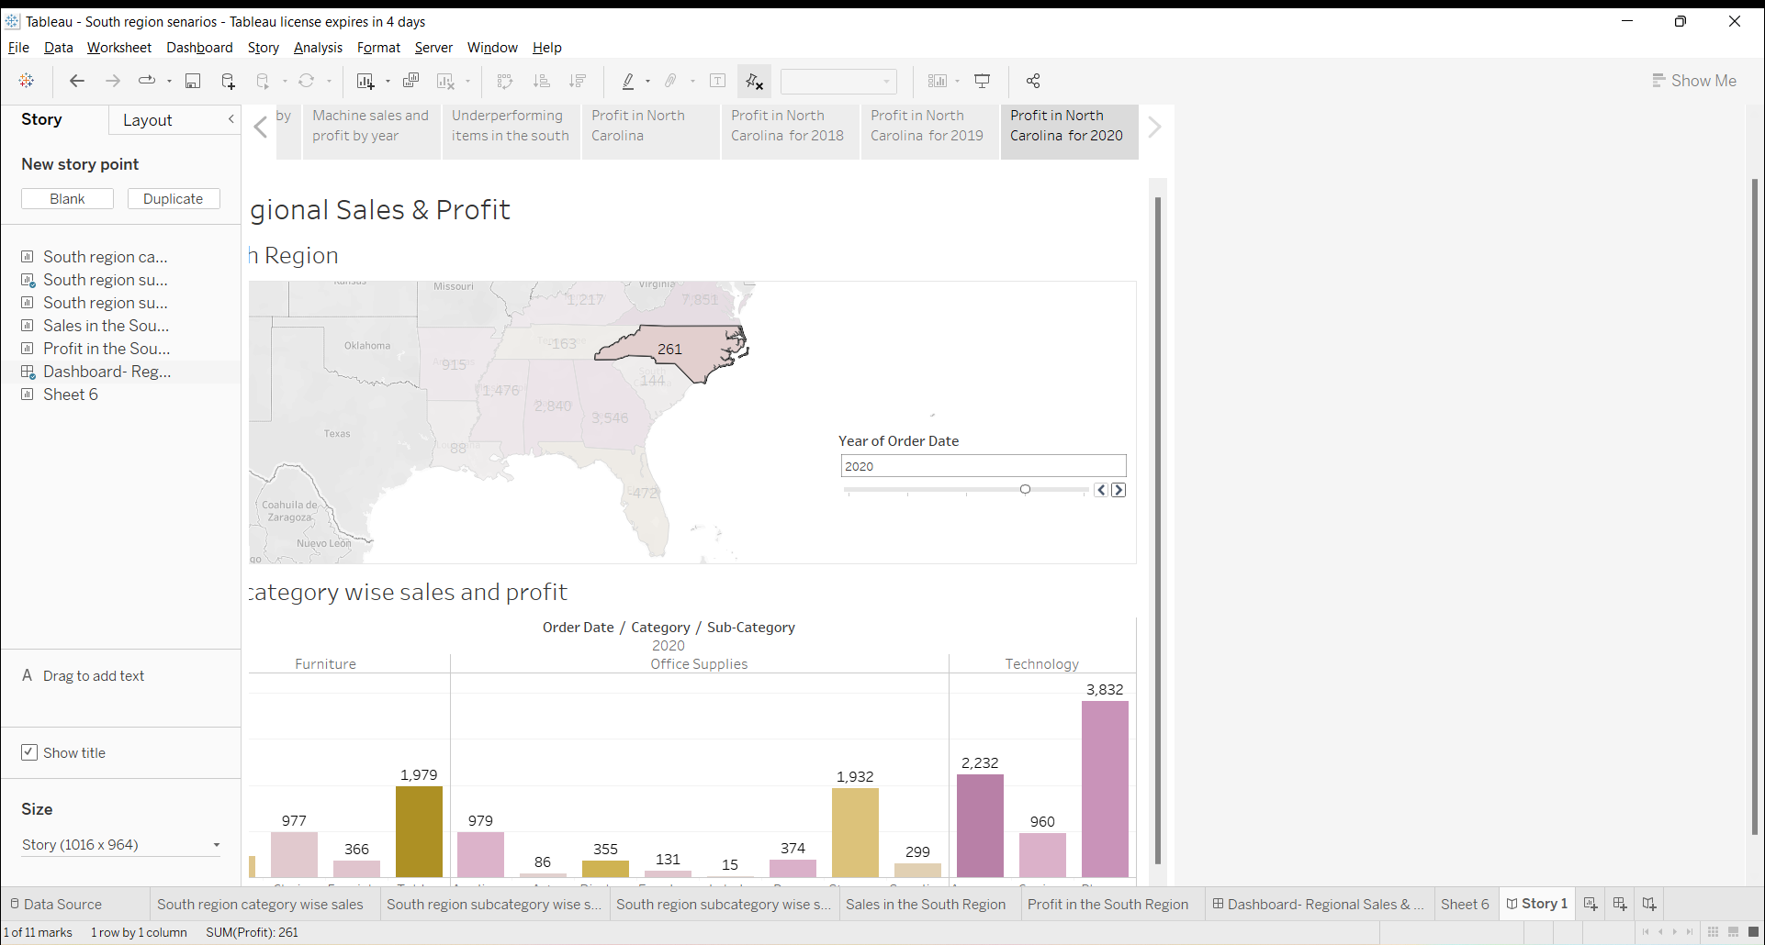

Slide 19
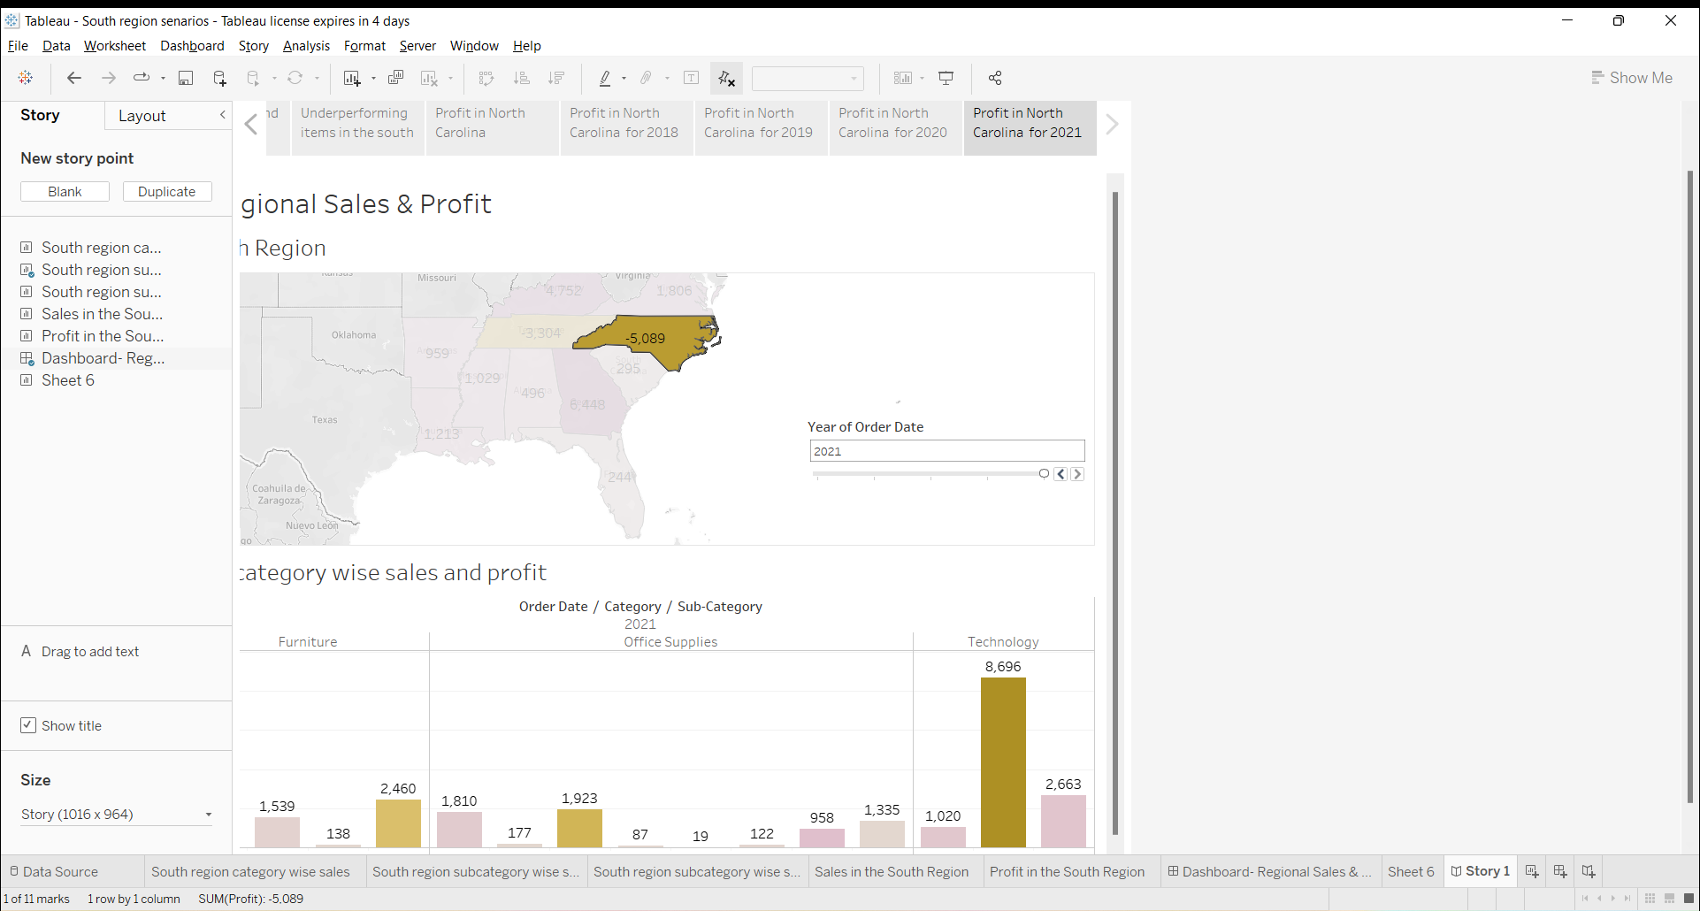

Slide 20
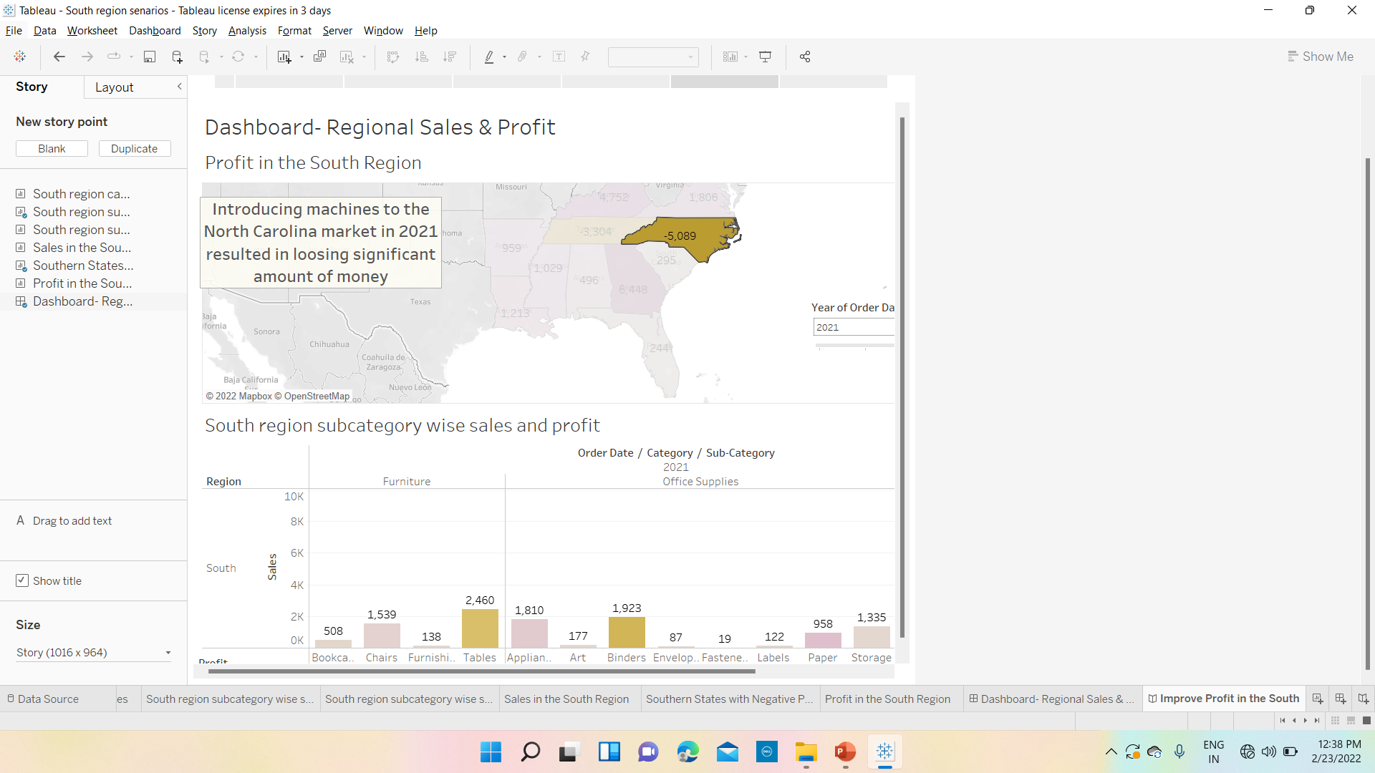
13. Select drag to add text, drag it onto your view and enter the description for your dashboard “introducing machines to the North Carolina market in 2021 resulted in loosing a significant amount of money”

Slide 21
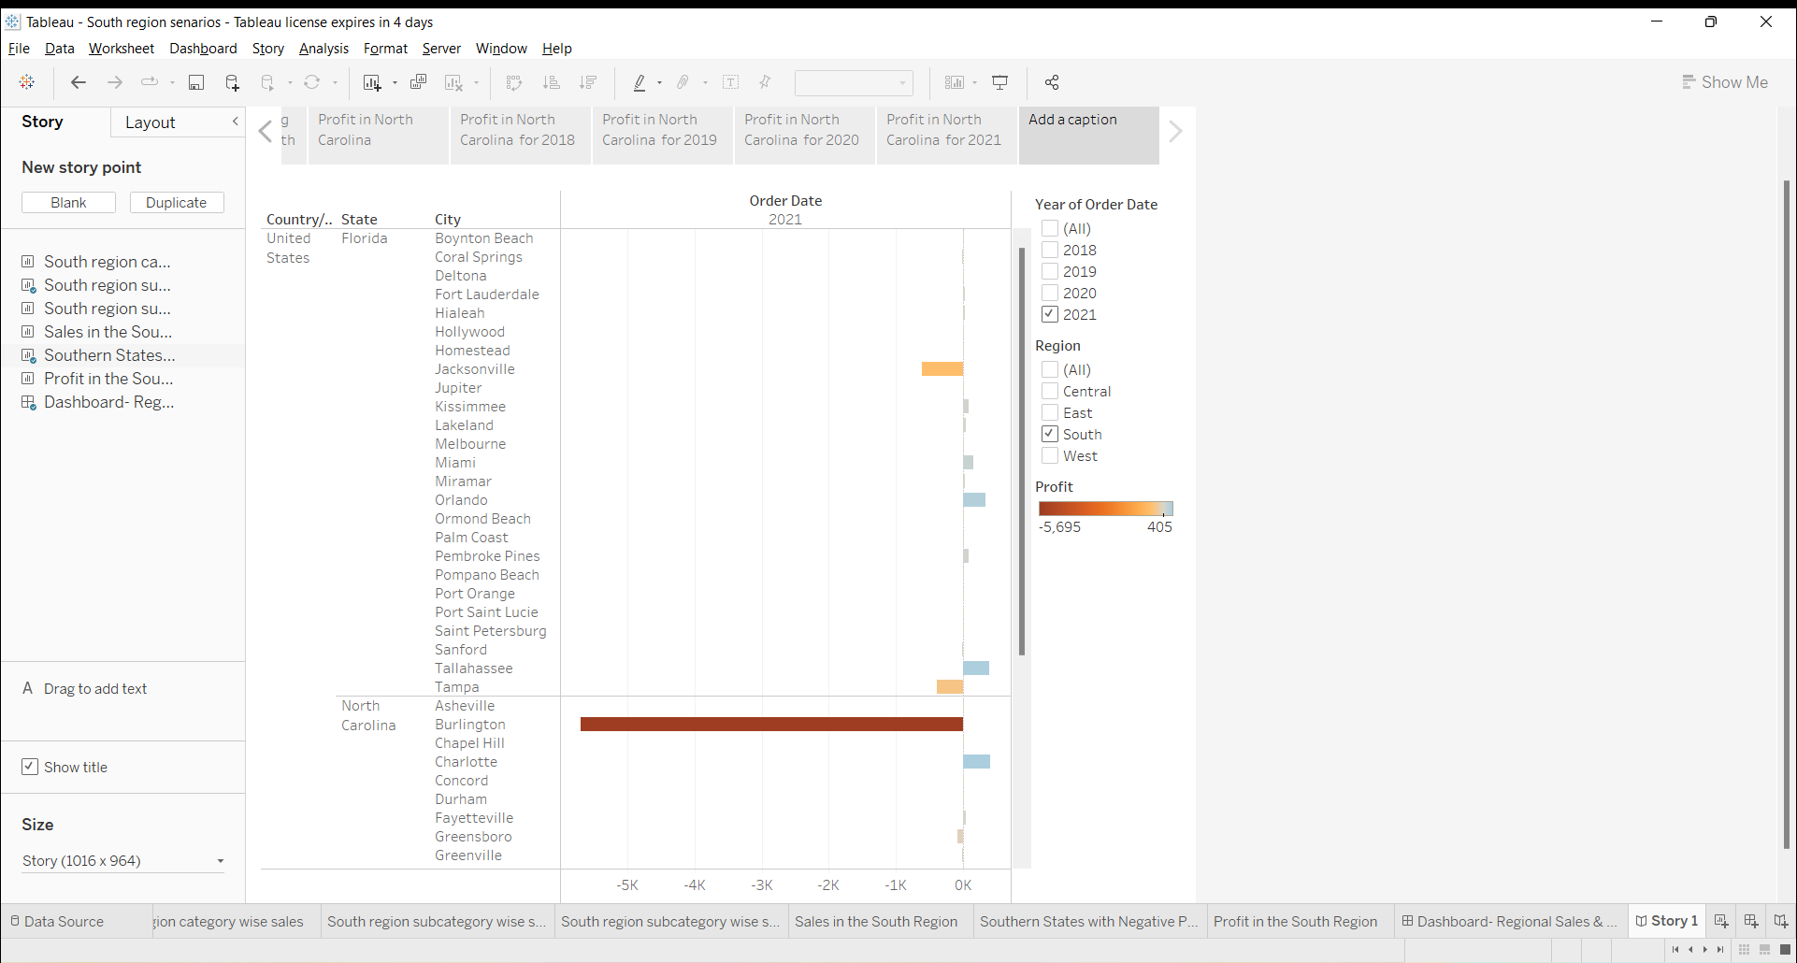
14. From the story pane, click blank and drag negative Profit bar chart to the view.

Slide 22
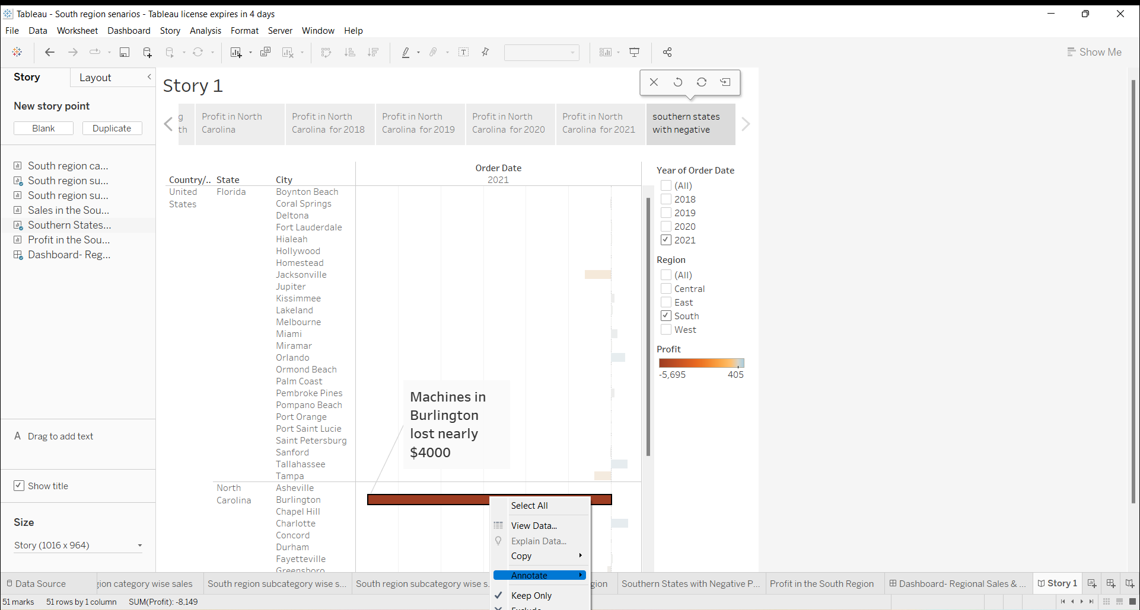
15. Right click on Burlington mark (the bar) and select annotate > mark. In the edit annotation dialog box that appears, delete the filter text and type “Machines in Burlington lost nearly $4000”.

Slide 23
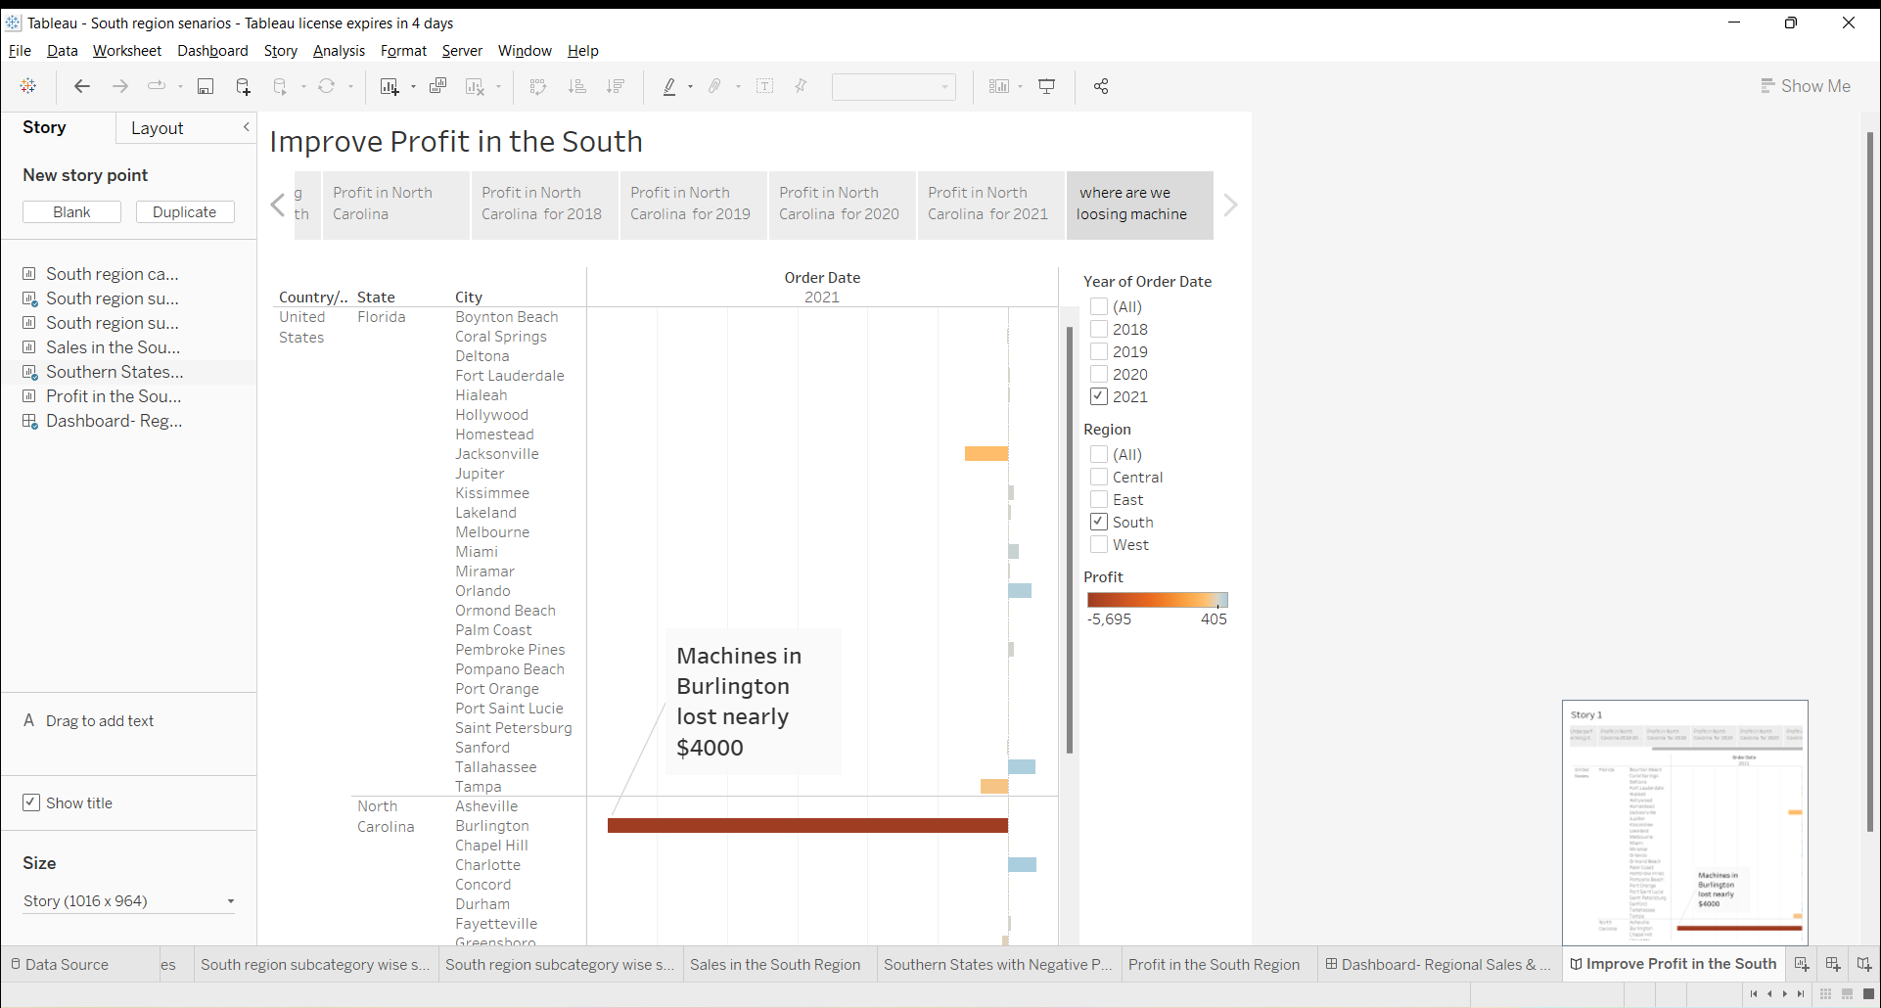
16. Add a caption “where we are loosing machine profits in North Carolina?” To above story point.

Slide 24
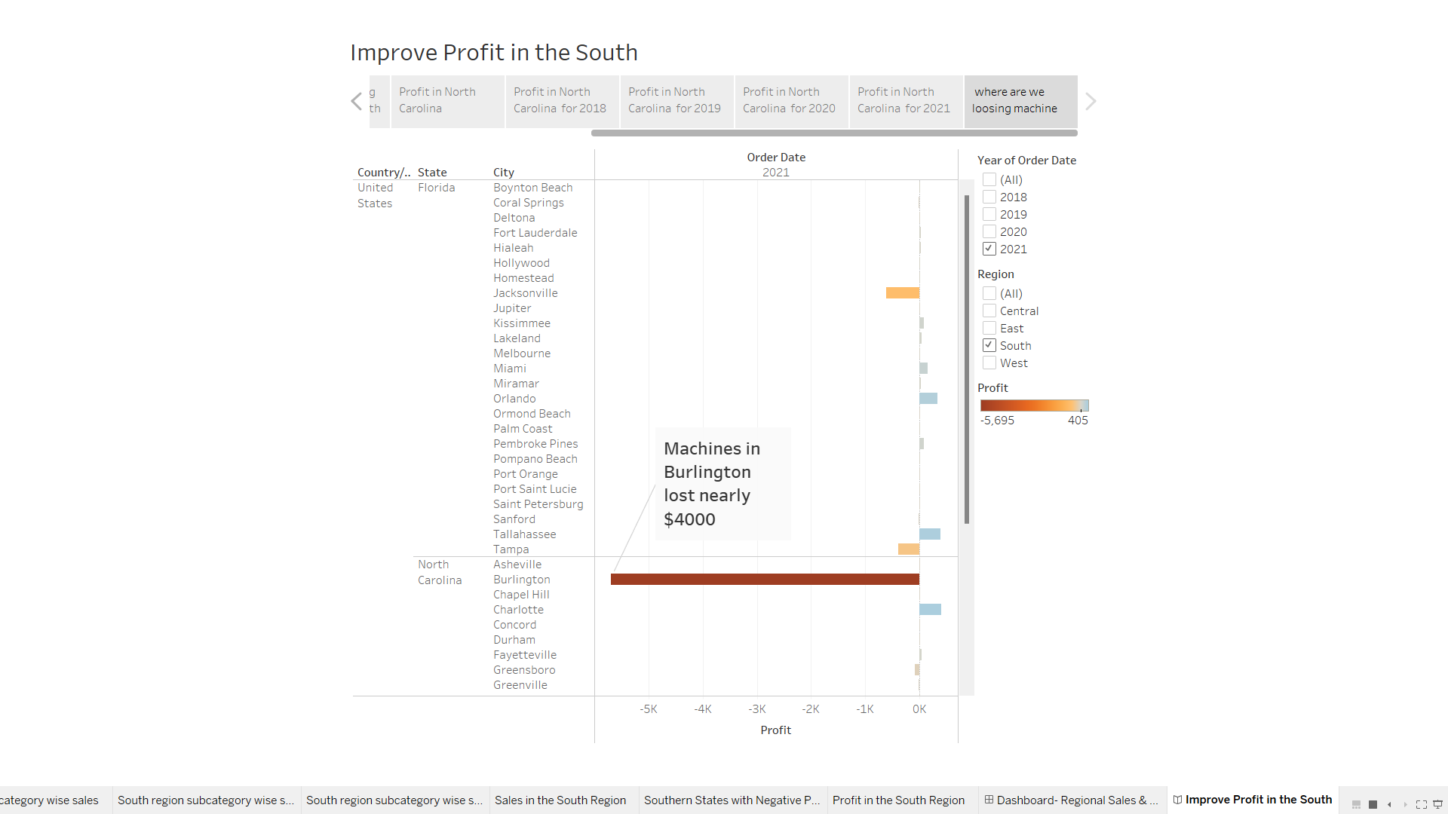
17. Rename your story as “Improve profits in the south” and check in the presentation mode.

Slide 25
18. Publishing the story created in Tableau in Tableau Public
Steps to publish in Tableau Public:
1. select server > Tableau Public > save to Tableau Public
2. Enter the Tableau public credentials in the dialog box.
3. If you don’t have Tableau Public profile, click to create one now for free and follow the prompts.
Note: Error occurs because our data in data source page was connected to ‘Live’ connection, so change it to ‘Extract’ then save (i.e Create Extract) and then save in Tableau Public.

Slide 26
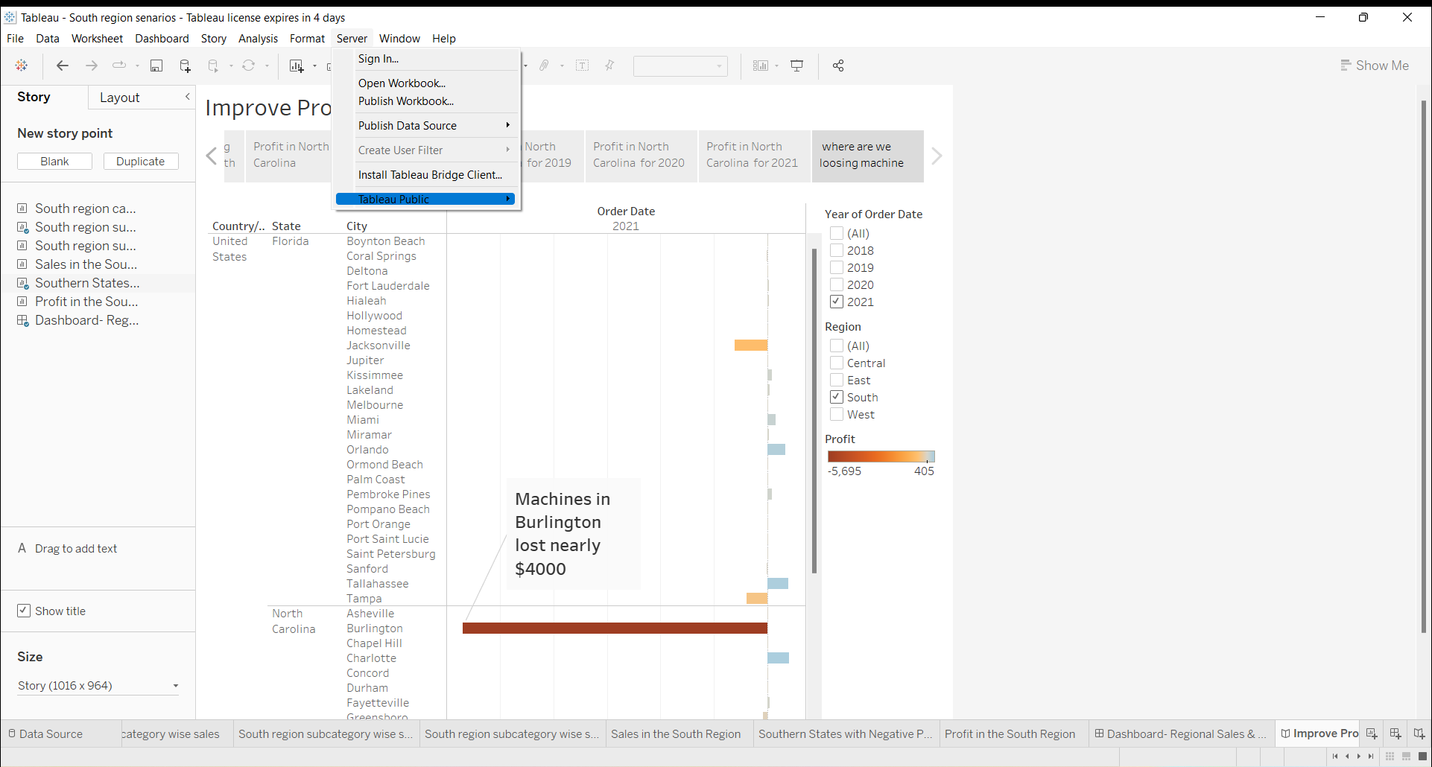

Slide 27
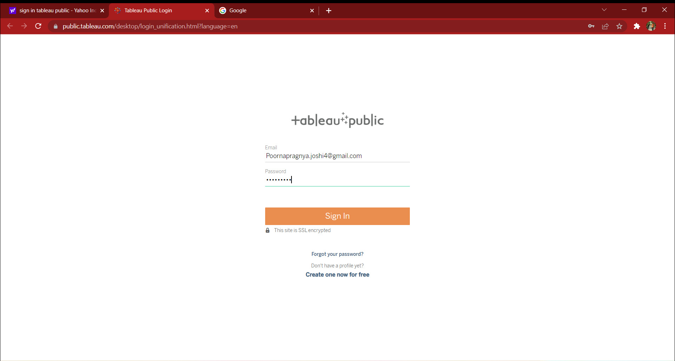

Slide 28
